Slide 1
What Makes a Startup Successful?
Taylor Niedzielski, Noah Suttora, Sonia Patel, Julia Nelson

Slide 2
Start-Up Companies
The Problem:
Startups can be costly from investment money and time commitment. There is confusion about which attributes can help or hurt a new company.
Notes:
Who?
This slide introduces the subject of the data.

Slide 3
Start-Up Success Rate
Objective:
Discover factors that positively impact and negatively impact success of American start-up companies.
Notes:
What and Why?
Target variable is success and why is it important.

Slide 4
Process to Meet Objective:
Get data
Extract information via exploratory data analysis
Gain knowledge using machine learning algorithms
Acquire wisdom to understand optimal actions

Slide 5
DATA

Slide 6
The Dataset
The data collected is from the years 1999-2013 with only American based companies.
Originally had 116 different attributes that we narrowed down to 43 attributes.
We narrowed down this list by:
Usability of attribute
Understandability of the attribute
Relevance of attribute
> 35% of attribute data missing
Notes:
How?
Talk about how the data will be classified and analyzed. Also, we can briefly discuss cleaning up the data.
1 Target (Dependent) Variable
41 Independent Variables
42 Variables Total
202 Samples Total (No samples were deleted from original data)

Slide 7
Cleaning The Dataset
The attributes with missing values were propagated with the mean, if they were a numerical type, or mode, if they were a categorical type.
We shortened the attribute names for clarity and conciseness.

Slide 8
Qualitative (Categorical) Data Variables
TeamSizeGrowth
TopCompanyExp
StartupExp
SuccessfulStartupExp
Big5Partner
ConsultingExp
HighestEducation
Fortune100Exp
Fortune 500Exp
Fortune1000Exp
FortuneExp
Focus Functions
ProductorService
DataFocus
ConsumerDataFocus
DataStructureFocus
SubscriptionBased
CloudPlatformBased
LocalGlobal
BusinessModel
CapitalIntensive
CrowdsourcingBased
CrowdfundingBased
B2BorB2C
GlobalExposure
PricingStrategy
HyperLocalisation,
LongtermFounderRelationship
RecessionalSurvival

Slide 9
Quantitative (Numeric) Data Variables
FoundingYear
Age
NumSeedInvestors
NumAngelorVCInvestors
NumFounders
NumAdvisors
GooglePageRank
NumDirectCompetitors
LastFundingRoundAmount
SeniorLeadershipTeamSize
EmployeesPerYear
NumFounderRecognition

Slide 10
2.) EXTRACT INFORMATION
Exploratory Data Analysis via Linear Regression

Slide 11
Correlation Coefficient (r) and Strength
|r| | Strength
0.70 - 1.00 | Very Strong
0.50 - 0.69 | Strong
0.30 - 0.49 | Moderate
0.10 - 0.29 | Weak
0.01 - 0.09 | Very Weak

Slide 12
No Correlation and Very Weak Correlation Variables
No Correlation (r = 0.0 or NA)
Very Weak Correlation (r = 0.01 - 0.09)
DataStructureFocus (+0.008)
NumFounderRecognition(NA)
CapitalIntensive (-0.02)
SuccessfulStartupExp(+0.02)
GlobalExposure (+0.02)
NumSeedInvestors(+0.03)
BusinessModel (+0.03)
NumFounders (+0.03)
NumAngelorVCInvestors(+0.05)
LastFundingRoundAmount(-0.04)
PricingStrategy (-0.06)
StartupExp (+0.06)
HyperLocalisation (-0.07)
ProductorService (-0.09)
Big5Partner (+0.09)
DataFocus (+0.09)
TopCompanyExp (+0.09)
Notes:
NONE COMMENTS
Julia: The Data Structure Focus of the company (Both,no,Structured,Unstructured) has no correlation with success (0.007592873) - No structure shows significant decrease in probability of success compared to Both, Structured, Unstructured similar to DataFocus
Sonia: The number of recognitions given to founder has no correlation to success.
VERY WEAK COMMENTS
Julia:
Although smaller sample for success of those that had Big5Partner experience and a very weak correlation, those with Big5Partner had higher probability of success Having experience with StartupExp increases probability of success slightly while experience with a SuccessfulStartupExp has almost no difference in probability of success while being closely related categories
Although a weak correlation - there is a significant decrease in probability of success if the company has “No” DataFocus than compared with Private/Public/Both
ProductorService - Increase in probability of success in companies with Both product & service compared to those with just Product or just Service
Noah: Surprisingly, global exposure marginally contributes to success although startups that did have it had a significantly higher chance of success.

Slide 13
Weak Correlation Variables (r = 0.10 - 0.29)
SubscriptionBased (+0.10)
TopCompanyExp (+0.10)
CloudPlatformBased (-0.10)
NumDirectCompetitors (-0.10)
CrowdsourcingBased (-0.12)
CrowdfundingBased (0.12)
HighestEducation (0.15)
Fortune100Exp (+0.16)
Fortune500Exp (+0.16)
Age (-0.17)
EmployeesPerYear (+0.17)
ConsumerDataFocus (+0.17)
ConsultingExp (-0.19)
Founding year (+0.19)
NumAdvisors (+0.19)
SeniorLeadershipTeamSize (+0.19)
FortuneExp (+0.20)
Fortune1000Exp (+0.21)
LongtermFounderRelationship (+0.23)
GooglePageRank (-0.26)
Notes:
WEAK COMMENTS
Julia:
TopCompanyExp (Presence of Previous Top Company Experience in Company) increases probability of success than those without
Focus on Consumer data shows an increase in probability of success
Noah: Crowdsourcing (gathering info/skills) and crowdfunding (gathering money/funds) have a similar impact on success due to their similar nature. Most that didn’t partake in either succeeded. However, all the businesses that crowdfunded succeeded where those that crowdsourced had a 62/38 chance of success/failure. Analyzing the immediate effects that money has on a startup vs analyzing the long-term effects that info/skills has on a startup would be a good thing to explore.
Sonia: It appears that the long-term relationship between founders contributes more to success than the previous work experience of employees. This provides a pivot point to analyze the teamwork quality of a company and its success. What company qualities should be on a webpage to ensure a higher GooglePageRank is a good thing to explore as well.

Slide 14
Moderate and Very Strong Correlation Variables
Moderate Correlation (r = 0.30 - 0.49)
Very Strong Correlation (r = 0.70 - 1.00)
B2BorB2C (-0.30)
LocalGlobal (-0.33)
RecessionSurvival (+0.73)
Notes:
MODERATE COMMENTS
Noah: B2B saw a significantly higher chance of success than failure where B2C was almost evenly split. This is most likely because other well-established businesses would do business with a startup if the risk was minimal or worth taking and their product was unique/valuable (aka potential in startup). Global saw a significantly higher chance of success than failure where local was almost evenly split. This is most likely because global businesses require more expertise and management than a local one.
Sonia: The greater the amount raised in the last round of funding, the greater likelihood of the company failing. At this stage, usually the company is established with a least one success product or service and is looking to expand their market share or product line. Usually last round funding comes with strings attached (payback with interest, dividend payouts, etc.) so maybe companies struggle to fulfill promises to heavy investors. In the case of failure, large capital losses are much harder to recover.
VERY STRONG COMMENTS
Sonia: The r given using the entire dataset is inaccurate because it included companies that were no running during the recession. So to obtain an accurate r for RecessionSurvival, I only used the 59 applicable companies (i.e. company’s running during the recession). A question to consider is what are the differences between the following three categories of companies: recession failure, recession survival but overall failure, and recession survival & overall success.

Slide 15
3.) GAIN KNOWLEDGE
Machine Learning Algorithms

Slide 16
Algorithms We Used
k-Nearest Neighbors (kNN)
Naive Bayes (NB)
Classification and Regression Tree (CART)
Random Forest (RF)
C5.0 Classification (C50)
Artificial Neural Network (ANN)
Notes:
In addition to the linear regression model used in EDA
kNN numeric
NB categorical
CART categorical (2 leveled)
RF categorical (2 leveled)
C5.0 categorical (2 leveled)
ANN all variables

Slide 17
k-Nearest Neighbors

Slide 18
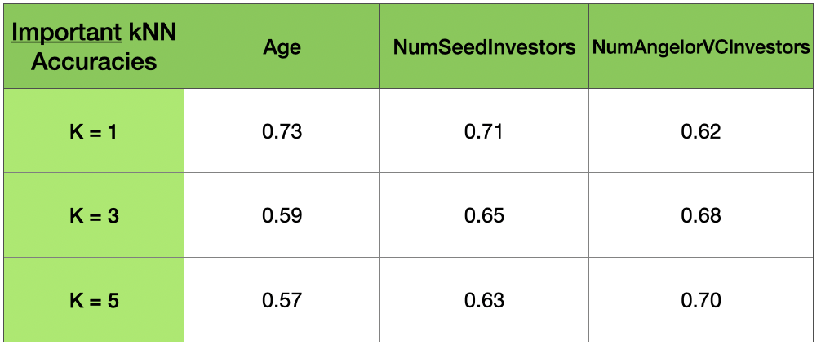
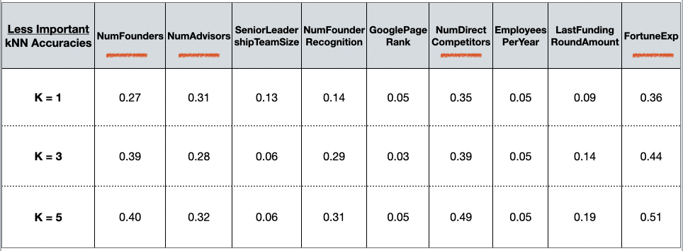
k-Nearest Neighbors
Applied on 11 variables
3 variables seem to play an important role in a company’s success
Average accuracy is about 65-70%...
We expect future models will be minimum 70-85% accurate
Notes:
On 11 quantitative variables
Very Weak Correlation from before: numSeedinvestors, NumAngelorVCInvestors, Num Founders
Weak Correlation from before: numAdvisors, NumDirectCompetitors, (FortuneExp -- deleted from table)
Found 3 variables to play important role in a company’s success (Age, NumSeedInvestors, NumAngelorVCInvestors) with highest accuracies
4 variables of less importance that could still important play a role in future models (seen with red line )
Some accuracies change between testings which is normal, but these differences still remain relatively similar outputs.
While age can be considered possibly important, we see a variance in predictions more than in others because occasionally it will produce a prediction with around 30% accuracy… and can be potentially attributed to having a small value of k that is leading to a large variance in predictions
Alternatively, setting k to a large value may lead to a large model bias.
Possible reason for not as strong a model could be the larger number of predictors in our data
After multiple implementations, it has been observed that the KNN algorithm does not work with good accuracy on taking large datasets because the cost of calculating the distance between the new point and each existing point is huge, and in turn, it degrades the
performance of the algorithm.
KNN gives us a baseline minimum accuracy that we should aim for in future models. Our kNN tests averaged around 65-70% so we should aim for accuracy of about 70-85%
While age can be considered possibly important, we see a variance in predictions more than in others because occasionally it will produce a prediction with around 30% accuracy… and can be potentially attributed to having a small value of k that is leading to a large variance in predictions
Alternatively, setting k to a large value may lead to a large model bias.
_________________STEPS
SIMPLE
Import the data
Read / clean / adjust the data (if needed)
Create a train / test split
Create the kNN model object
Fit the model
Predict
Evaluate the accuracy
STEPS MORE DETAIL___________________________
KNN is a supervised learning algorithm (dependent variable exists)
K-nearest neighbor tries to determine the classification of a point, combines the classification of the K nearest points
Take the K Nearest Neighbor of unknown data point according to distance.
Among the K-neighbors, Count the number of data points in each category.
Assign the new data point to a category, where you counted the most neighbors.
___________
setting to center and scale tells us that we are standardizing our independent variables
center : subtract mean from values.
scale : divide values by standard deviation.
attr(,"scaled:center")
Status—Age—TeamSizeGrowth—NumSeedInvestors
1.83 4.78 1.52 1.91
attr(,"scaled:scale")
Status—Age—TeamSizeGrowth—NumSeedInvestors
0.38 2.83 0.50 3.57
_____________
Features of KNN algorithm:
KNN is a supervised learning algorithm, based on feature similarity.
Unlike most algorithms, KNN is a non-parametric model which means it does not make any assumptions about the data set. This makes the algorithm simpler and effective since it can handle realistic data.
KNN is considered to be a lazy algorithm, i.e., it suggests that it memorizes the training data set rather than learning a discriminative function from the training data.
KNN is often used for solving both classification and regression problems.
Disadvantages of the KNN algorithm:
After multiple implementations, it has been observed that the KNN algorithm does not work with good accuracy on taking large datasets because the cost of calculating the distance between the new point and each existing point is huge, and in turn, it degrades the performance of the algorithm.
It has also been noticed that working on high dimensional data is quite difficult with this algorithm because the calculation of the distance in each dimension is not correct.
It is quite needful to perform feature scaling i.e., standardization and normalization before actually implementing the KNN algorithm to any dataset. Eliminating these steps may lead to wrong predictions by the KNN algorithm.
Sensitive to noisy data, missing values and outliers: KNN is sensitive to noise in the dataset. We need to manually impute missing values and remove outliers.
https://www.geeksforgeeks.org/k-nn-classifier-in-r-programming/

Slide 19
Naïve Bayes

Slide 20
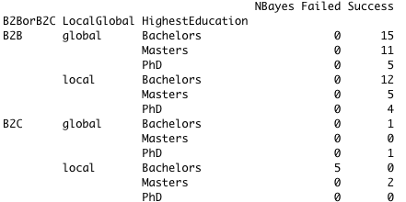
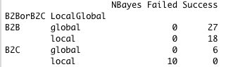
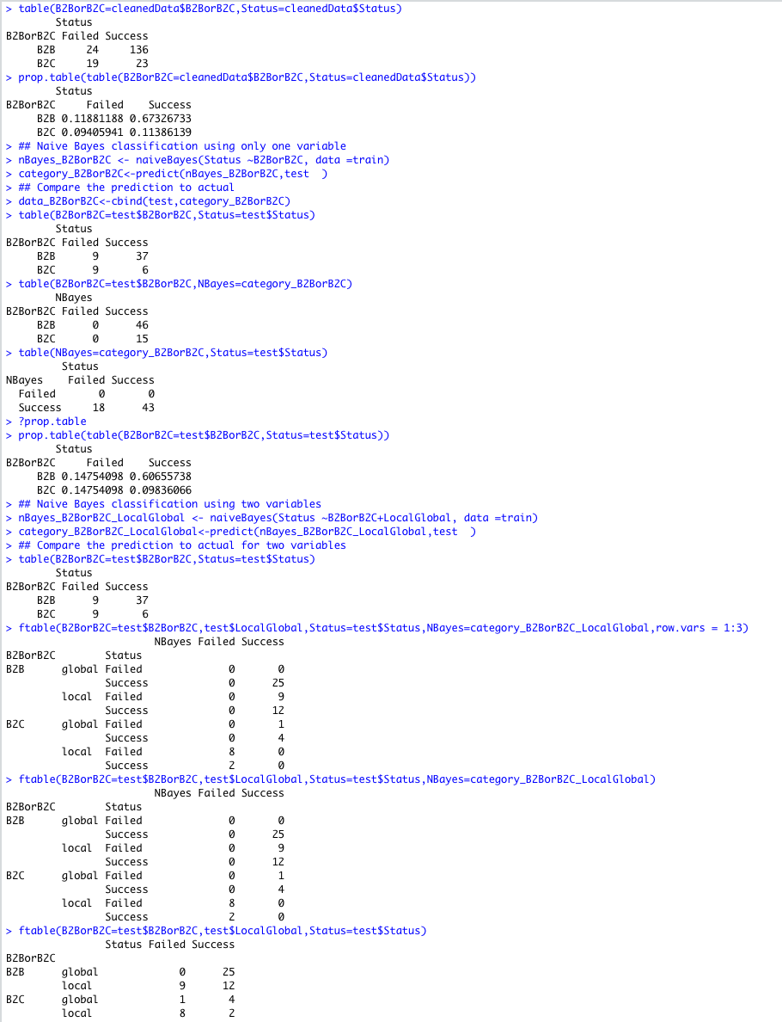
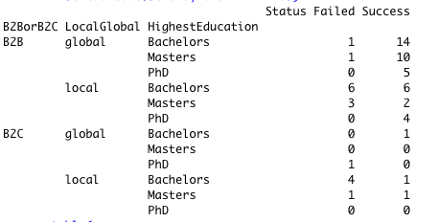
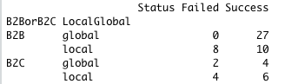


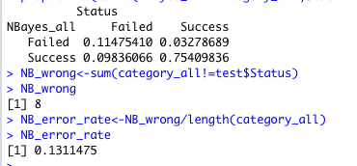
Naive Bayes
B2BorB2C + LocalGlobal + HighestEducation
Predicted
B2BorB2C + LocalGlobal
B2BorB2C
Predicted
Predicted
Actual
Actual
Actual
Compared
Compared
Compared
NB Error rate: 0.30
NB Error rate: 0.26
NB Error rate: 0.23
All Categories
Notes:
Categorical
Biz2BizorBiz2Consumer + LocalGlobal + HighestEducation
B2BorB2C + LocalGlobal chosen because one of the higher correlations calculated before - moderate correlation
HighestEducation chosen because its middle ground correlation value, qualitative category with multiple levels
assumes that the features of each data point are all independent:
and the output is just a classifier so if we added a new variable in we would be able to determine which class it would fall into
____TAKE-AWAYS
We can see error rate get getting(smaller) as we include more features into the model (0.30 , 0.26, 0.23)
When Naive Bayes of all categories is compared to the actual status of the company, we can see their probabilities of outcomes.. however we can test the error and find that in this test of NB, it predicted 8 incorrectly out of a total of 61 giving us an error rate of about 13.11
Compared to other testings of this NB method, the error rate stayed between 13-22% giving us a pretty accurate model with 78-87% accuracy rates.
_______
(extra PICTURE) OF A-PRIORI PROBABILITIES- vector with prior probabilities of the classes. If unspecified, the class proportions for the training set are used. If present, the probabilities should be specified in the order of the factor levels
Assuming that the features of each data point are all independent: is convenient because it lets you multiply everything together
Naive Bayes is a Supervised Non-linear classification algorithm in R Programming. Naive Bayes classifiers are a family of simple probabilistic classifiers based on applying Baye’s theorem with strong(Naive) independence assumptions between the features or variables. The Naive Bayes algorithm is called “Naive” because it makes the assumption that the occurrence of a certain feature is independent of the occurrence of other features.

Slide 21
Classification and Regression Tree
Notes:
KEY Takeaway:
The first tree method we use was CART analysis.
The Decision Tree Analysis were conducted on categorical variables with two levels (Yes and No).
There were 23 total variables taken into consideration.
In our correlation analysis, we noticed that Recession Survival strongly correlated with overall Success of the businesses. So we want to explore what “decisions” the businesses made that affected the outcome. We also wanted to dive deeper into the differences between businesses that survived the recession but did not succeed overall and business that survived the recession and succeed overall.
One CART Decision Tree was constructed for all samples and a second CART Decision Tree was constructed for samples that had to endure through the recession.

Slide 22
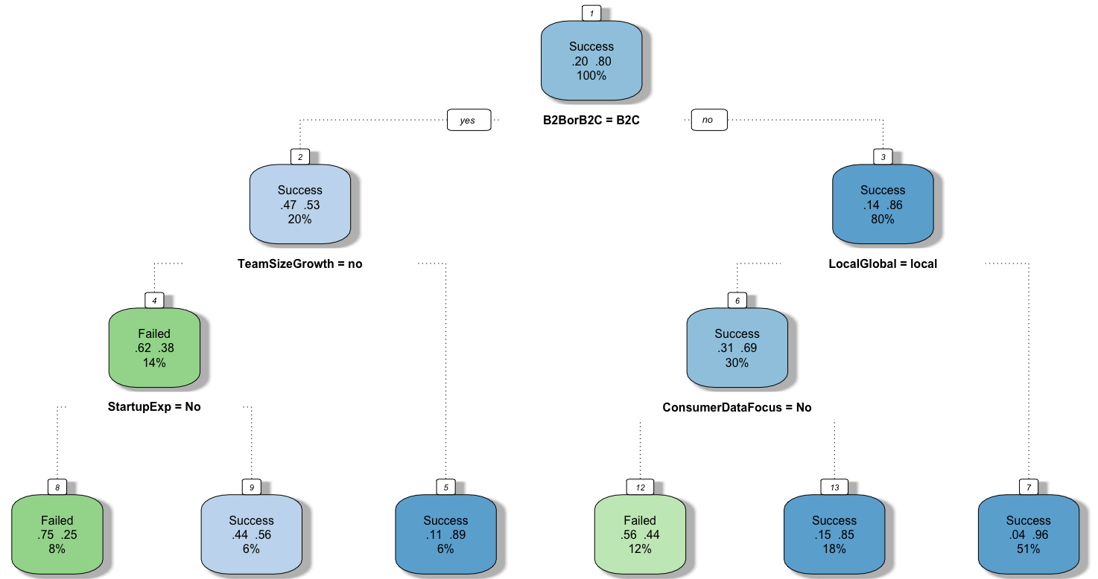
CART - All Samples
B2C
B2B
NO
Team Size Growth
Global Focus
NO Previous Startup Experience
Notes:
KEY Takeaway:
This decision tree was generated using the dataset’s 23 categorical variables with two-levels and includes all samples.
The tree has 13 nodes and accounts for 5 variables.
Business Product Model
Team Size Growth
Geographic Focus
Previous Startup Experience
Consumer Data Focus
This tree shows that the most success kind of startup, noted in green, has a Business to Business Model and Global Focus.
The least successful kind of startup, noted in red, has a Business to Consumer Model, NO Team Size Growth, and NO Previous Startup Experience.
The tree shows that B2B, Global Focus, and NO Consumer Data Focus will likely be positive.
And B2C, NO Team Size Growth, NO Previous Startup Experience, and a Consumer Data Focus will likely be negative.
Highlight Nodes
Classification and Regression Tree (All 202 Samples)
Error Rate = 0.18
The decision tree has 13 nodes that account for 5 variables.
B2B or B2C
Team Size Growth
Local Global
Startup Experience
Consumer Data Focus
Paths (From left to right)
B2C → NO Team Size Growth → NO Startup Experience → FAILED (Node 8)
B2C → NO Team Size Growth → Startup Experience → SUCCESS (Node 9)
B2C → Team Size Growth → SUCCESS (Node 5)
B2B → Local Focus → NO Consumer Data Focus → FAILED (Node 12)
B2B → Local Focus → Consumer Data Focus → SUCCESS (Node 13)
B2B → Global Focus → SUCCESS (Node 7)
Node 7 is by far the most successful path with accounting for 51% successes.

Slide 23
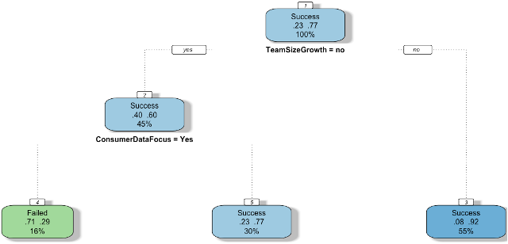
CART - Recession Samples
NO Team Size Growth
Team Size Growth
Consumer Data Focus
Notes:
KEY Takeaway:
We generated ANOTHER CART using the dataset’s 23 categorical variables with two-levels, but included only samples with recession data.
We did a CART for samples with recession data, because RecessionSurivival had a very strong correlation with Startup Success.
And we wanted to see if there would be a difference in positive and negative factors.
The tree has 5 nodes and accounts for 2 variables.
Team Size Growth
Consumer Data Focus
This tree shows that the most success kind of startup, noted in green, has a Team Size Growth.
The least successful kind of startup, noted in red, had NO Team Size Growth and a Consumer Data Focus.
In the case of recession, a having Team Size Growth and NO Focus on Consumer Data will positively impact success.
Classification and Regression Tree (59 Recession Samples)
Error Rate = 0.40
The decision tree has 5 nodes that account for 2 variables.
Team Size Growth
Consumer Data Focus
Paths (From left to right)
NO Team Size Growth → Consumer Data Focus → FAILED (Node 4)
NO Team Size Growth → NO Consumer Data Focus → SUCCESS (Node 5)
Team Size Growth → SUCCESS (Node 3)
Node 3 is by far the most successful path with accounting for 55% of successful startups.

Slide 24
Random Forest
Notes:
KEY Takeaway:
Next, we performed a Random Forest Model in order to find out which variables had the most importance when estimating our target variable.
The Decision Tree Analysis were conducted on categorical variables with two levels (Yes and No).
There were 23 total variables taken into consideration.
One Random Forest Fit was constructed for all samples and a second Random Forest Fit was constructed for samples that had to endure through the recession.
In our correlation analysis, we noticed that Recession Survival strongly correlated with overall Success of the businesses. So we want to explore what “decisions” the businesses made that affected the outcome. We also wanted to dive deeper into the differences between businesses that survived the recession but did not succeed overall and business that survived the recession and succeed overall.

Slide 25
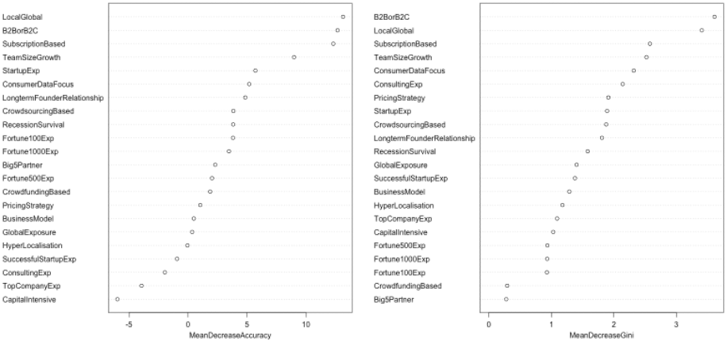
Random Forest - All Samples
Mean Decrease Accuracy
Mean Decrease Gini
Notes:
KEY Takeaway:
First we made a Random Forest model was generated using the dataset’s 23 categorical variables with two-levels and includes all samples.
The variables with the most impact on accuracy are the Geographic Focus, Business Product Model, and Presence of a Subscription Based Model.
Variables with the least impact on the accuracy are Capital Intensive, Previous Top Company Experience, and Previous Consulting Experience.
The most important variables when estimating the Success of a Start-Up are Business Product Mode and Geographic Focus.
MDA
Top 3 MDA for All
Local Global (>10)
B2B or B2C (>10)
Subscription Based (>10)
MDG
Top 3 MDA for All
B2B or B2C (>3)
Local Global (>3)
Subscription Based (>2.5)
Random Forest (All 202 Samples and All 23 Variables)
Error Rate of Entire Forest = 0.1967213
Mean Decrease in Accuracy (MDA) refers to the accuracy of single tree models. It does not provide concrete information on the overall accuracy of the entire forest.
Gini Impurity is a metric that determines how the data splits into smaller groups. It measures how often a randomly chosen record from the training data set is incorrectly labeled if it’s labeled according to the distribution of labels in the subset. For example, if 50% of records = "A" and 50% of records = "B", a record randomly labeled based on the group’s composition has a 50% chance of being wrongly labeled. Gini Impurity reaches 0 when all records in a group fall into a single category. For example, if there is only one possible label in a group, a record will be given that label 100% of the time. Basically, the Gini Impurity measures the probability of a new record being incorrectly classified at a given node in a Decision Tree, based on the training data.
Mean Decrease in Gini (MDG) measures a variable’s importance for estimating the target variable (Success/Failure). It is the mean of a variable’s total decrease on node impurity weighted by the proportion of samples reaching that node in each individual tree in the random forest.
MDA
Top 3 MDA for All
Local Global (>10)
B2B or B2C (>10)
Subscription Based (>10)
Random Forest (All 202 Samples without Capital Intensive Variable)
Error Rate of Entire Forest = 0.1967213 (No Change)
Capital Intensive has approximately -6 MDA and 1.1 MDG but there is no change in accuracy when it is removed. WHY? This implies that the error does not account for negative values.
Random Forest (All 202 Samples without B2B/B2C Variable)
Error Rate of Entire Forest = 0.2131148 (+0.0163935)
B2B or B2C has approximately 14 MDA and 3.5 MDG and accuracy decreases by 8% when it is removed. This is consistent with the RF Fit Graphs.

Slide 26
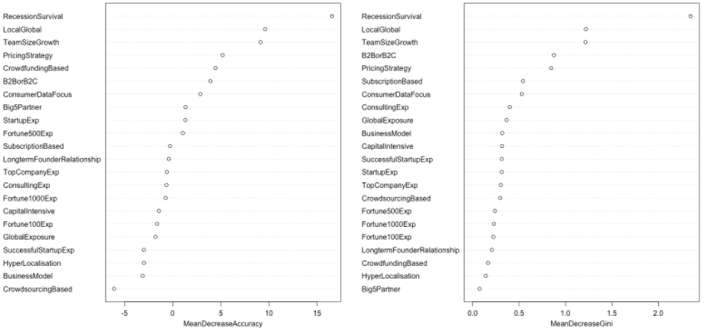
Random Forest - Recession Samples
Mean Decrease Accuracy
Mean Decrease Gini
Notes:
KEY Takeaway:
Next we made a Random Forest model only using recession samples.
The variables with the least impact on the accuracy are Crowdsourcing Based Model, Business Model, and Hyperlocalisation.
The variables with the most impact on accuracy are the Recession Survival, Geographic Focus, and Team Size Growth.
These three variables are also the most important variables when estimating the Success of a Start-Up.
MDA
Top 3 MDA for All
Recession Survival (>15)
Local Global (>10)
Team Size Growth (>10)
MDG
Top 3 MDA for All
(>3)
Local Global (>3)
Subscription Based (>2.5)
Random Forest (59 Recession Samples and All 23 Variables)
Error Rate of Entire Forest = 0.2777778
Random Forest (59 Recession Samples without Crowdsourcing Based Variable)
Error Rate of Entire Forest = 0.277778 (No Change)
Crowdsourcing Based has approximately -6 MDA and 0.4 MDG but there is no change in accuracy when it is removed. WHY?
Random Forest (59 Recession Samples without Local Global Variable)
Error Rate of Entire Forest = 0.2222222 (+0.055556)
Local Global has approximately 10 MDA and 1.3 MDG and accuracy decreases by 20% when it is removed. This is consistent with the RF Fit Graphs.
Top 3 MDA for RS
Recession Survival (<15)
Local Global (10 to 15)
Team Size Growth (10 to 15)
B2B or B2C and Subscription based decreased two levels in RS.
Team Size Growth increased two levels in RS.

Slide 27
C5.0 Classification
Notes:
KEY Takeaway:
Next, we performed a C5.0 Classification to generate a tree for all samples using the 23 two-levels categorical variables.

Slide 28
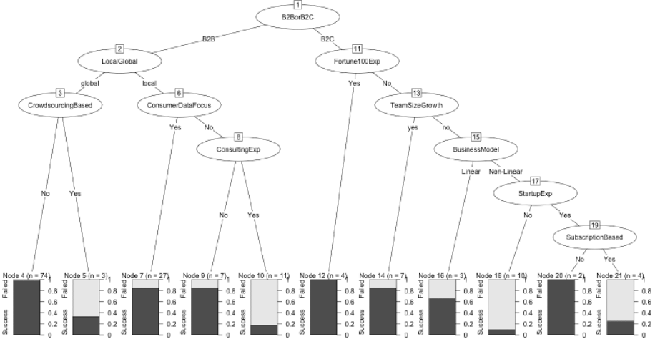
C50
Node 4
Node 12
Node 18
Node 20
Notes:
KEY Takeaway:
The tree has 21 nodes and accounts for 10 variables.
The tree shows 3 groups of Startup characteristics will 100% Success, noted in Green.
Node 4 shows that a Globally Focused, Business-to-Business Model that is NOT Crowdsourcing Based had a 100% rate of success.
Node 12 shows that a Business-to-Consumer Model with Prior Fortune100 Experience had a 100% rate of success.
Node 20 shows that a Non-Subscription Based, Non-Linear Business-to-Consumer Model is favored if Team Size does not grow and the team has NO Fortune 100 Experience, but Previous Startup Experience.
The tree shows 1 groups of Startup characteristics will 90% Failure.
The least successful kind of startup, noted in red, has a Non-Linear Business to Consumer Model, NO Prior Fortune 100 or Startup Experience and NO Team Size Growth.
The C5.0 Model provide information on a variety of variables.
The tree shows that a NON-Subscription Based Model, Consumer Data Focus, NO Crowdsourcing, NO Consulting Experience, Previous Fortune 100 Exp, Team Size Growth, and will likely be positive.
While Crowdsourcing, Previous Consulting Experience, a Subscription Based Model, and NO Previous Startup Experience will likely be negative.
C5.0 Tree (All 202 Samples)
Error Rate = 0.22
The C50 Tree has 21 nodes that account for 10 variables.
B2B or B2C MS
Local Global MS
Fortune 100 Experience
Crowdsourcing Based
Crowdfunding Based
Team Size Growth
Consulting Experience
Business Model
Startup Experience
Subscription Based
Pathways (From left to right)
B2B → Global Focus → NOT Crowdsourcing Based → SUCCEED 1.0 (Node 4)
B2B → Global Focus → Crowdsourcing Based → FAILED 0.6 (Node 5)
B2B → Local Focus → Consumer Data Focus → SUCCEED 0.8 (Node 7)
B2B → Local Focus → NO Consumer Data Focus → NO Consulting Experience → SUCCEED 0.8 (Node 9)
B2B → Local Focus → NO Consumer Data Focus → Consulting Experience → FAILED 0.8 (Node 10)
B2C → Fortune 100 Experience → SUCCEED 1.0 (Node 12)
B2C → NO Fortune 100 Experience → Team Size Growth → SUCCEED 1.0 (Node 14)
B2C → NO Fortune 100 Experience → NO Team Size Growth → Linear Business Model → SUCCEED 0.6 (Node 16)
B2C → NO Fortune 100 Experience → NO Team Size Growth → Non-Linear Business Model → NO Startup Experience → FAILED 0.9 (Node 18)
B2C → NO Fortune 100 Experience → NO Team Size Growth → Non-Linear Business Model → Startup Experience → NOT Subscription Based → SUCCEED 1.0 (Node 20)
B2C → NO Fortune 100 Experience → NO Team Size Growth → Non-Linear Business Model → Startup Experience → Subscription Based → FAILED 0.8 (Node 21)
Question: Why are some variables of more concern to B2B vs. B2C. How does C50 determine this?
C5.0 measures predictor importance by determining the percentage of training set samples that fall into all terminal nodes after the splits.
The C5.0 algorithm does this by measuring the entropy of a sample. The entropy of a sample of data indicates how mixed the class values are; the minimum value of 0 indicates that the sample is completely homogenous, while 1 indicates the maximum amount of disorder.
The algorithm uses entropy to calculate the change in honmogeneity resulting from a split on each possible feature. This calculation is referred to as information gain. If after a split, the data is divided into more than one partition, a second entropy calculation considers the total entropy across all of the partitions by weighing each partition’s entropy by the proportion of records falling into that partition. The higher the information gain, the better a feature is at creating homogenous groups after a split on that feature.
In our C5.0 tree, the splits after B2C and B2B are made based on the information gain determined by the algorithm to turn out homogenous groups (bottom level nodes).

Slide 29
Artificial Neural Network Analysis

Slide 30
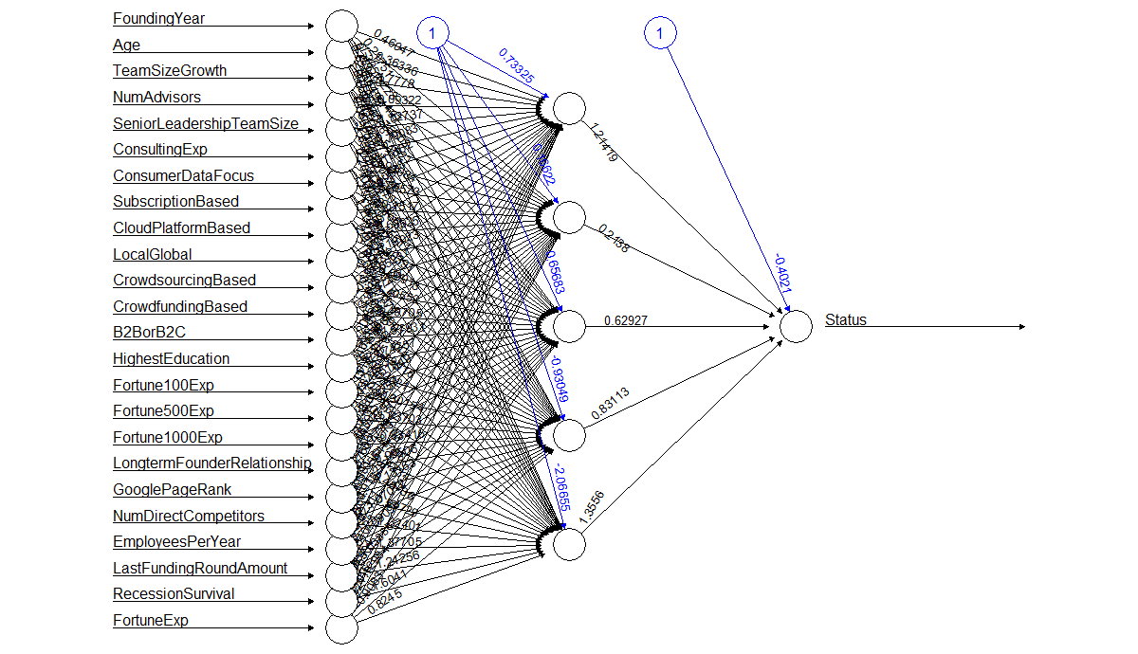
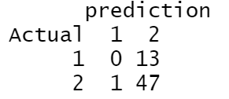

ANN with 5 Hidden Nodes
Where 1 = failure and 2 = success
Notes:
Used: 24 numerical/categorical variables
Removed: FocusFunctions and columns with no/very weak correlation
5 hidden nodes:
Great accuracy with predicting success
Misclassified all failure as success
->because of significant amount of success as opposed to small amount of failure

Slide 31
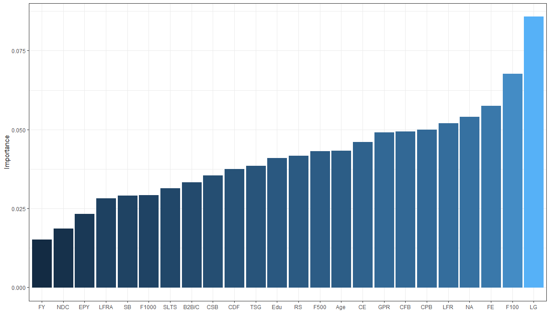
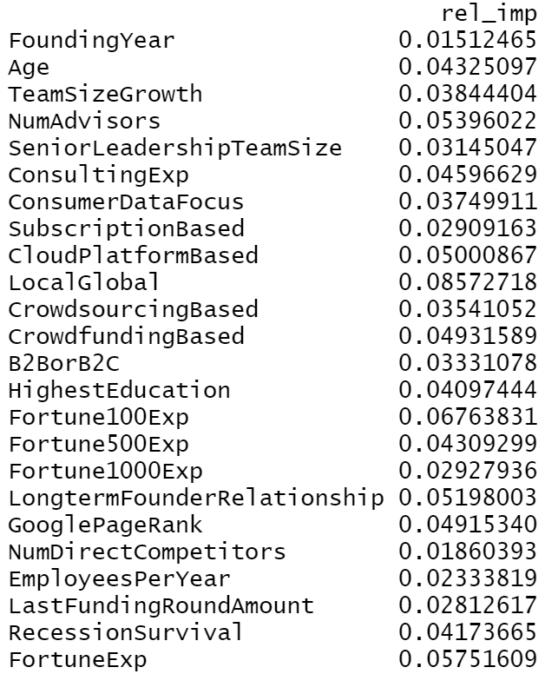
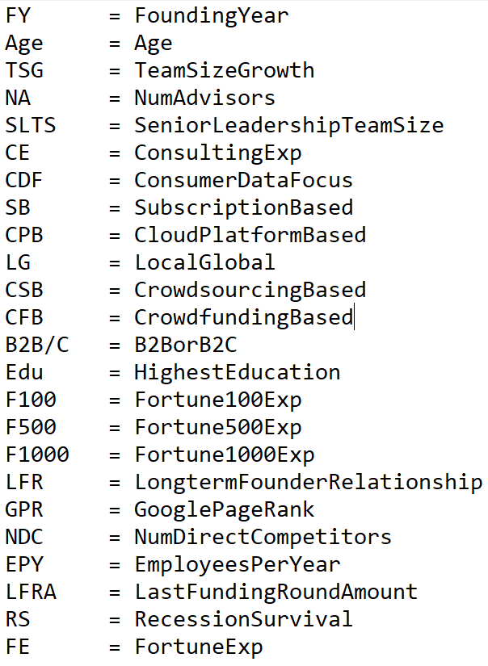
ANN with 5 Hidden Nodes Analysis
Importance
Acronym list
Notes:
Garson algorithm:
- relative importance (strength of association) of input variables in neural networks by deconstructing the model weights
- determined by identifying all weighted connections between the nodes
- the connections are tallied for each input node and scaled relative to all other inputs
- a single value is obtained for each explanatory variable that describes its relationship with nn model
Top 3 most important variables with 5 hidden, 77% acc:
- LocalGlobal
- Fortune100Exp
- FortuneExp

Slide 32
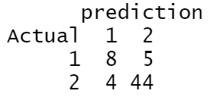
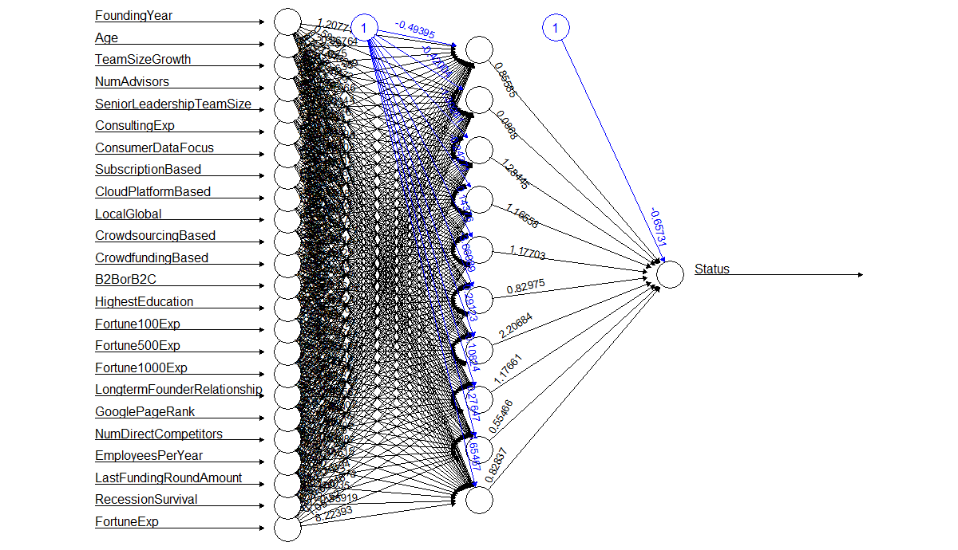

ANN with 10 Hidden Nodes
Where 1 = failure and 2 = success
Notes:
Used: 24 numerical/categorical variables
Removed: FocusFunctions and columns with no/very weak correlation
10 hidden nodes:
Still great accuracy (but slightly lower than 5 hidden nodes) with predicting success
Greater accuracy with classifying failures but could be better if more rows with failureof significant amount of success as opposed to small amount of failure

Slide 33
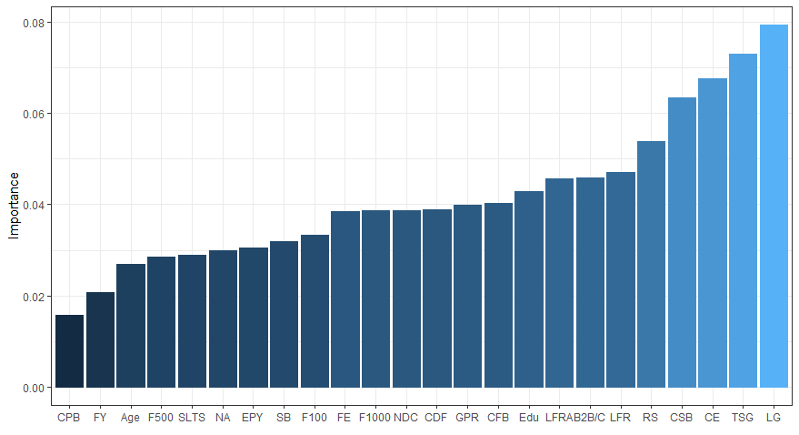

ANN with 10 Hidden Nodes Analysis
Importance
Acronym list
Notes:
Top 3 most important variables with 10 hidden, 85% acc:
- LocalGlobal
- TeamSizeGrowth
- ConsultingExp

Slide 34
4.) ACQUIRE WISDOM TO UNDERSTAND OPTIMAL ACTIONS

Slide 35
Key Takeaways
Business Models:
The Business-to-Business model has an advantage over Business-to-Consumer model.
Global startups have a significant advantage over local startups.
Properties of Employees:
Quality of employees has a greater impact on the success of a business during a recession.
Consulting experience usually has a negative impact on success.
Startup Experience has a positive impact regardless of previous failure.
Future Research:
To prevent overfitting or underfitting a future model, all latter models should aim for a minimum of 70% kNN and Naive Bayes accuracy.
Notes:
Catering a business to business model is a more effective way to have a relationship with the customer rather than a business to customer. We got a 70% for our knn and naive bayes. They are the simplest models and usually the most accurate, so future models should be based off the accuracy of them.

Slide 36
Future Research
Business to Business Startups:
Question: Why is Business to Business model more effective than Business to Consumer?
Hypothesis: Easier to get market (less sales, easy to establish trust, less competition)
Local vs Global Startups:
Question: Why do global startups have a significantly higher chance of success?
Hypothesis: most less experienced groups go local (less cost, less expertise needed), while more experienced groups go global (higher monetary gain, significant expertise needed)
Notes:
B2B Taylor
Local/Global NOAH

Slide 37
Future Research (Continued)
Start-Ups by Consultants
Question: Why does consulting experience negatively impact success?
Hypothesis: Consultants have expertise on specific company functions while neglecting overall company functionality which may lead to decreased start-up success.
Start-Ups during Economic Recession
Our dataset only had 59 recession samples, so another future study with more samples allow for classification models of higher accuracy.
Notes:
Consulting and Recession
KEY Takeaways:
Our models showed the Previous Consulting Experience was linked to Startup Failure.
A future study that dives deeper this would be interesting.
We hypothesize that consulting experience gives an expertise of specific company functions (little picture) while neglecting overall company functionality (big picture) which may lead to decreased start-up success.
Some variables to measure are years of experience, kinds of experience, and consulting field.
This study would be helpful in uncovering why consulting experience and startup success do not mix.
Another future study could be on Startup during the Recession
We only had 59 recession samples in our data and a future study with more samples would greatly increase model accuracy.

Slide 38
Bibliography
Kaggle: https://www.kaggle.com/sujithsherigar/startup-success-rate-analysis?select=CAX_Startup_Data.csv
Neural Net Tools package: https://rpubs.com/julianhatwell/annr

Slide 39
Questions?

